Slide 1



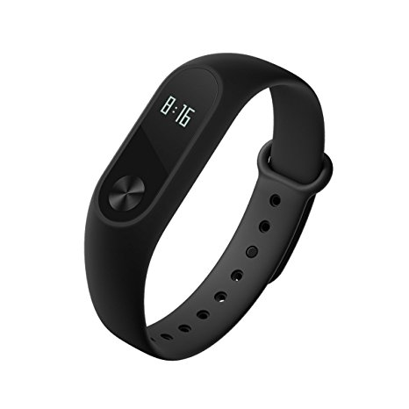
-Shashi Shivaraju

Slide 2
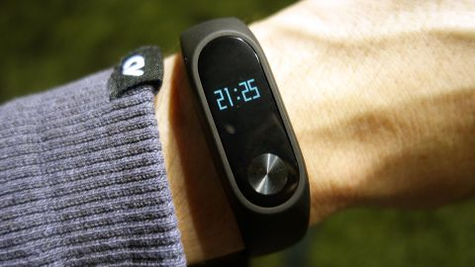
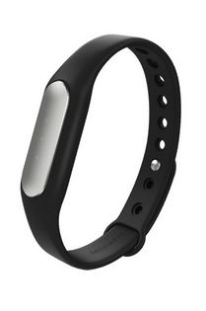
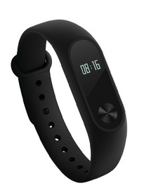
Introduction
Xiaomi Mi Band 2 is wearable activity tracker/fitness tracker.
An activity tracker/fitness tracker, is a device or application for monitoring and tracking fitness-related parameters.
It is a fitness device that you wear on your wrist like a watch.
It was released on 7 June, 2016 as a successor to Xiaomi Mi Band 1s and is the latest release in the Mi Band product line.
Retail price is $30
Mi Band 1s
Mi Band 2

Slide 3






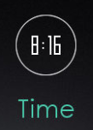
Motivation & Metrics
Motivation: Low cost wearable device for health conscious individuals & athletes to assist them in maintaining good physical health by monitoring their physical activities and rest.
Metrics :
Mi Band 2 using its internal sensors to monitor users physical activity and provides estimated metrics summarizing the step count, linear distance and the calories burnt due to physical activity.
It also provides data which describes users sleep pattern and variation in their heart rate.

Slide 4
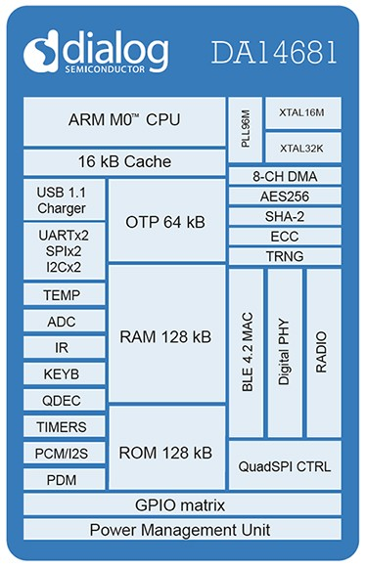
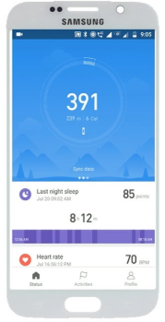

System Design: Block Representation
Motion Sensor
SoC
3-Axis Accelerometer
ADI-ADXL362-$4.87
Dialog DA14681 Low Power Chip - $2.56
Display
0.42" OLED
70 x 40 Pixels - $2.5
Proximity Sensor & Heart Rate Monitor
Photoelectric PPG sensor - $3.67
Mi Fit App
Power Supply
70 mA Lithium polymer battery - $4.5
Memory
Winbond W25X20CL –$0.46
256 kB Serial Flash Memory
Mi Firmware v1.01.81

Slide 5
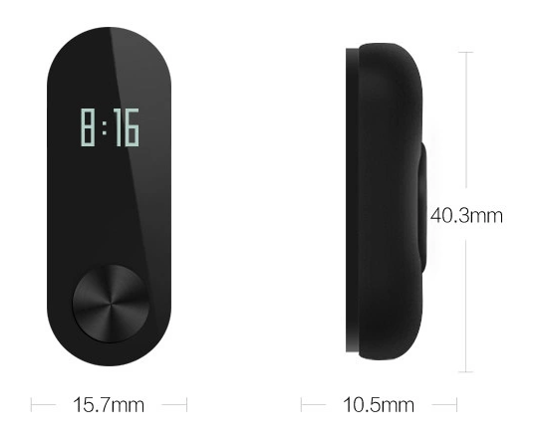
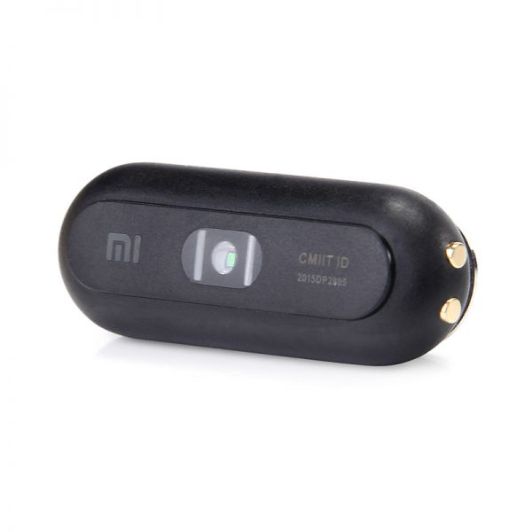
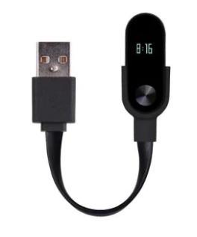
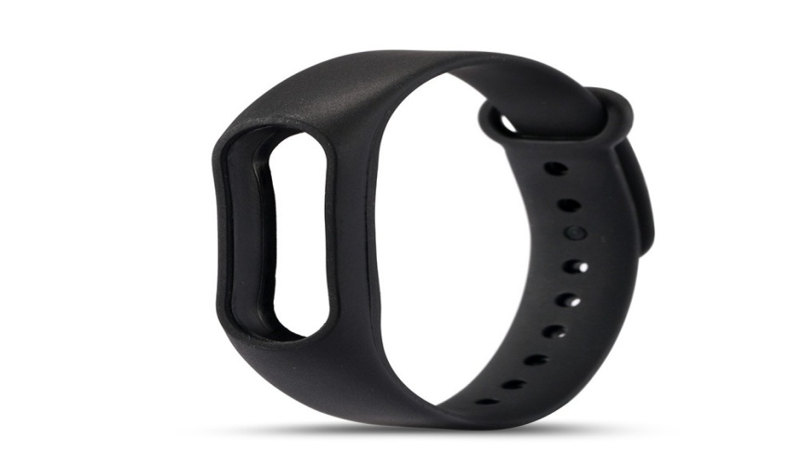
Teardown - External
Mi Core -Front View
Mi Core -Rear View
Plastic & aluminium alloy Body
Thermoplastic elastomer aluminium alloy Band -$0.59
USB charger - $0.55

Slide 6
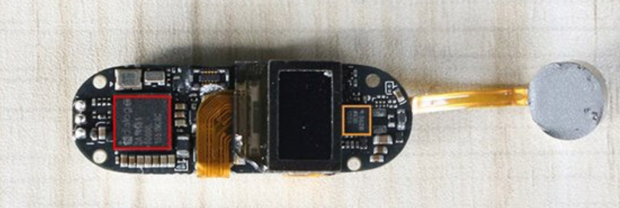
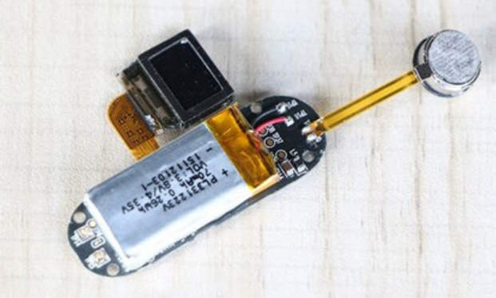
Teardown - Internal
PCB
3-Axis Accelerometer
ADI-ADXL362
Dialog DA14681 Low Power SoC
0.42" OLED Display
Vibrator
70 mA Lithium
polymer battery

Slide 7
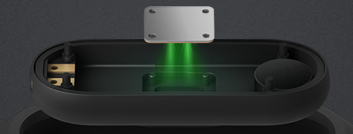
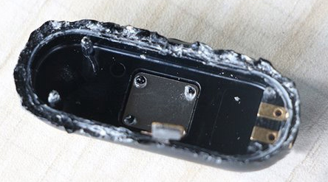
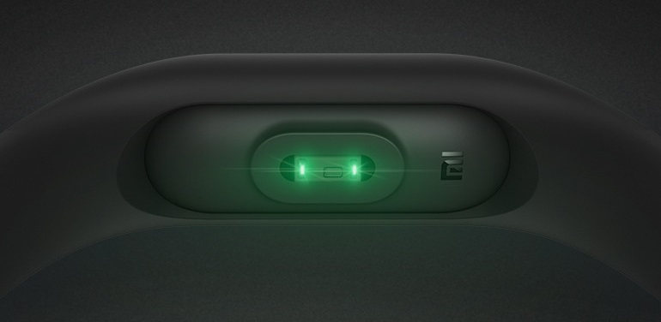
Teardown - Internal
Photoelectric PPG sensor

Slide 8
SWOT Analysis
Strength :
Low cost – Value for money
(Mi -$30 Vs Fitbit - $100 for similar specs)
Good Battery life - Standby time of 20 days
IP67 Water & Dust resistant
Compatible with native Mi Fit and 3rdparty apps like Google Fit.
Weakness :
Inaccurate Metrics – Sensor data can be inaccurate & Algorithms involve certain level of guessing.
Supports only Static Heart Rate Monitoring.
Device Design is subpar & it is built using cheap plastic.
Opportunities:
Incorporate GPS tracking.
Improve Algorithms to reduce errors.
Provide user calibration option to improve accuracy.
Support Dynamic Heart Rate Monitor.
Threats:
Smart Shoes – claim better physical activity tracking.
Smart watches – have necessary hardware to implement all the functions of activity tracker along with premium design.
Conclusion : Mi Band 2 is a low cost device for assisting users to live more active lifestyles and not for the accurate data collection.
Its a good buy for motivation not data.

Slide 9


